Slide 1
Week 08: Solving Problems using Loops CS 110 - Introduction to Programming
Brother W. Clements

Slide 2

Prepare
Kahoot Quiz: cse110-08-2 Loops

Slide 3

Prepare
Questions about
Infinite vs Finite
Loops
Exit strategy, container
For var in […] @[]-list
Array
range
While (<condition>)
Must change the condition - exit, or stack overflow
len
When to use?
For: I know the beginning and end – finite
While: I don’t know when it will end – infinite
Nesting loops

Slide 4
Lecture
See Classroom example
For
Nested For Loop

Slide 5

Checkpoint
What is your favorite number? 5
The sum of the numbers from 0 to 5 is: 15
What is your favorite number? 42
The sum of the numbers from 0 to 42 is: 903
What is your favorite number? 25000
The sum of the numbers from 0 to 25000 is: 312512500
Steps
Read instructions -
Demonstrate your understanding of loops by completing the following individual checkpoint assignment.
Attempt coding the problem for 1 hour
Sum up a number
Test:
Examples
0
2
Other inputs
Negative
Look at the Instructor code after 1 hour or when done.
Include in notes, what you learned from the instructor's code

Slide 6

Teach: Team Activity List of Numbers
Meet and setup a video call, share screen
Overview
When learning multiplication in school, students often write out multiplication tables where numbers are written along the top of each column and on the left side of each row. Then, the student fills in each spot in the table as the product of the number at top of the column and the left of the row.
Core requirements
Ask number?
Output 1st line
Output rows
Stretch Challenge
Display 3 spaces apart
Per number spacing
Test 5, 12, 32
Teacher Solution
Nested for loop
{the_number:.2f}
print("This is line one.", end="yyy“)
Submission
In notes tell me what you learned from the teacher solutions.
(X,Y)
1 2 3 4 5 6 7 8 9 10 11 12
2 4 6 8 10 12 14 16 18 20 22 24
3 6 9 12 15 18 21 24 27 30 33 36
4 8 12 16 20 24 28 32 36 40 44 48
5 10 15 20 25 30 35 40 45 50 55 60
6 12 18 24 30 36 42 48 54 60 66 72
7 14 21 28 35 42 49 56 63 70 77 84
8 16 24 32 40 48 56 64 72 80 88 96
9 18 27 36 45 54 63 72 81 90 99 108
10 20 30 40 50 60 70 80 90 100 110 120
11 22 33 44 55 66 77 88 99 110 121 132
12 24 36 48 60 72 84 96 108 120 132 144

Slide 7
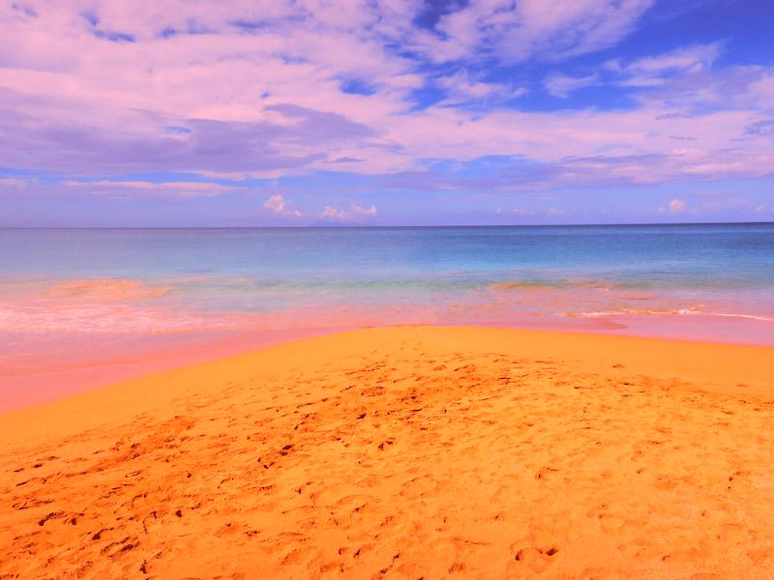
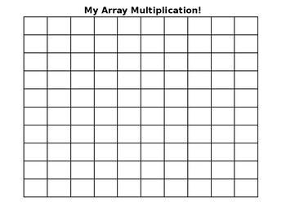
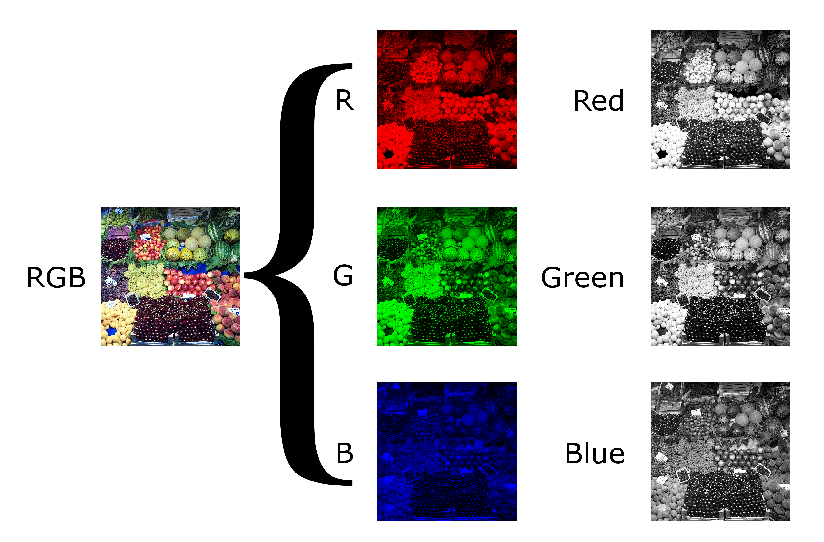
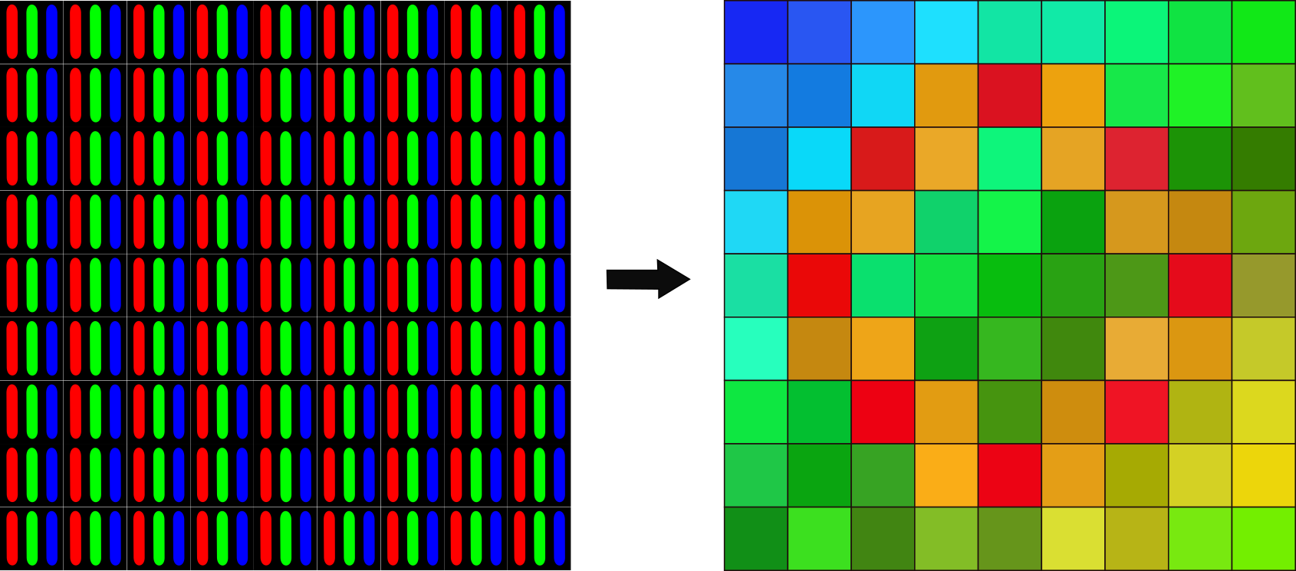
(X=0,Y=0)
[x, y] or i.e. [42, 300]
(X=0,Y=0)
r1, g1, b1 =
pixels_original[x, y]
0-255
(X=0,Y=0)
(X=0,Y=0)

Slide 8
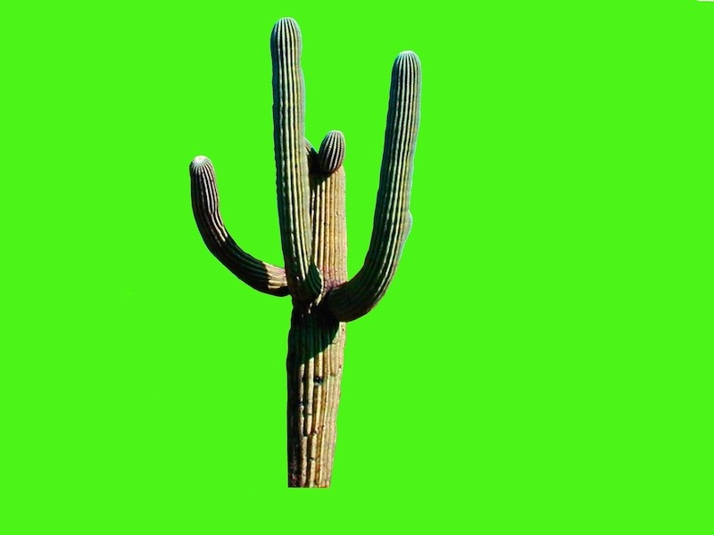
(X,Y)
(X,Y)
(X,Y)
(X+width,Y+height)
(X+width,Y+height)
(X+width,Y+height)
image_original = Image.open("beach.jpg")
image_original = Image.open(“catus.jpg")
image_new = Image.new("RGB", image_original.size)
width, height = image_original.size
width, height = image_foreground.size
(X,Y)
pixels_original1 = image_original.load()
pixels_foreground = image_ foreground.load()
pixels_new = image_new.load()
r1, g1, b1 = pixels_original[x, y]
r2, g2, b2 = pixels_foreground[x, y]
pixels_new[x, y] = (r3, g3, b3)
LOGIC: "if g is greater than something and r and b are less than something else, do the following." ***Hint copy either pixel 1 or pixel 2 into new

Slide 9
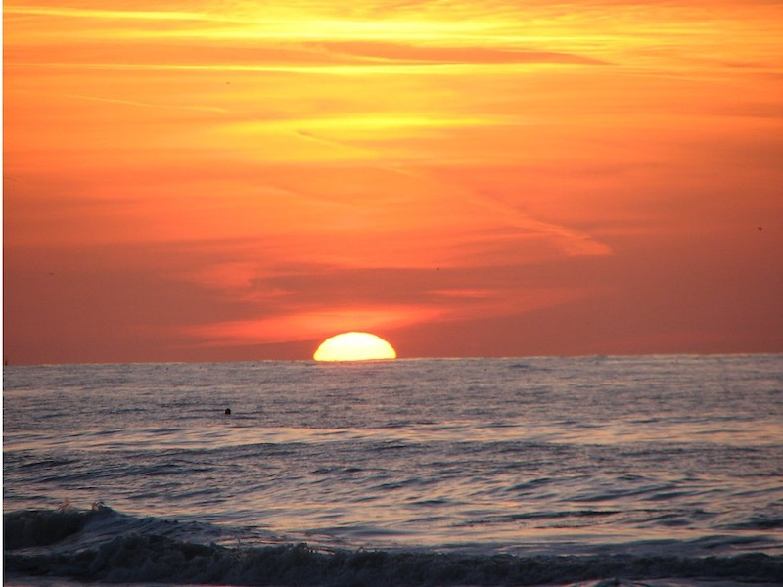
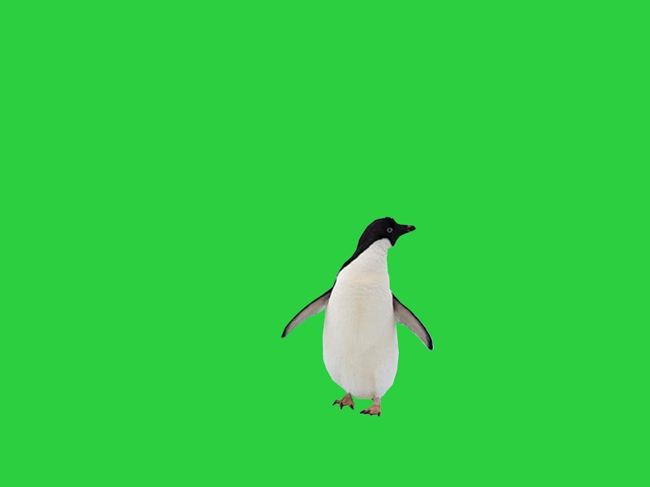
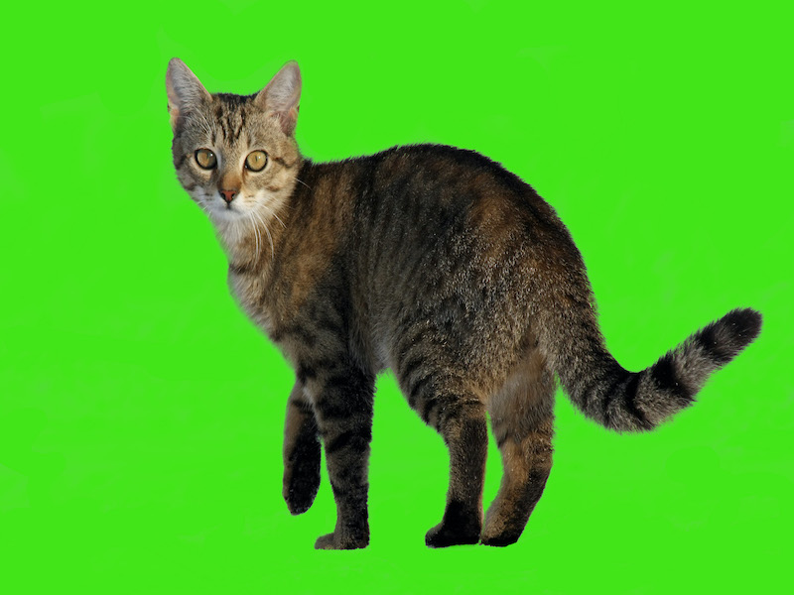
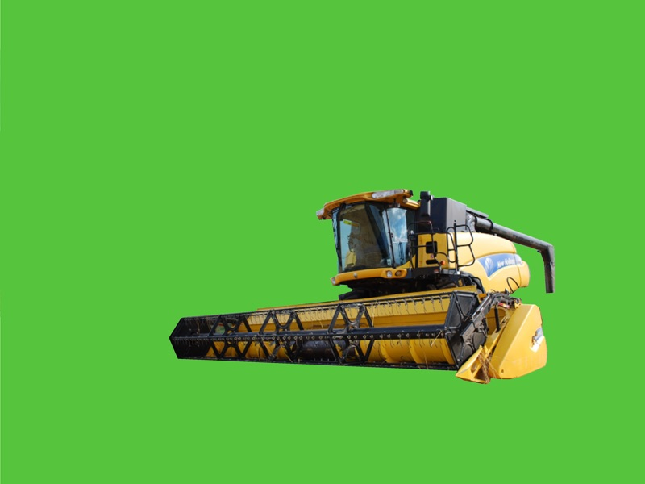
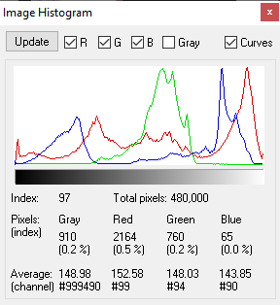
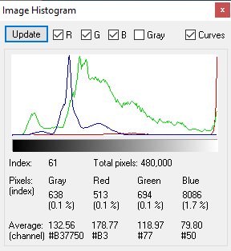
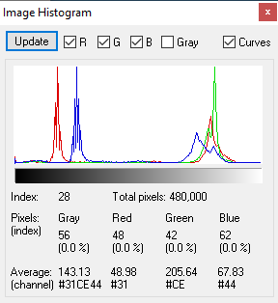
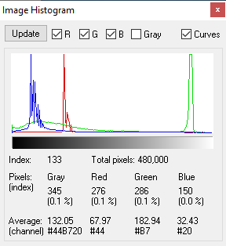
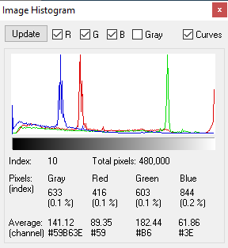
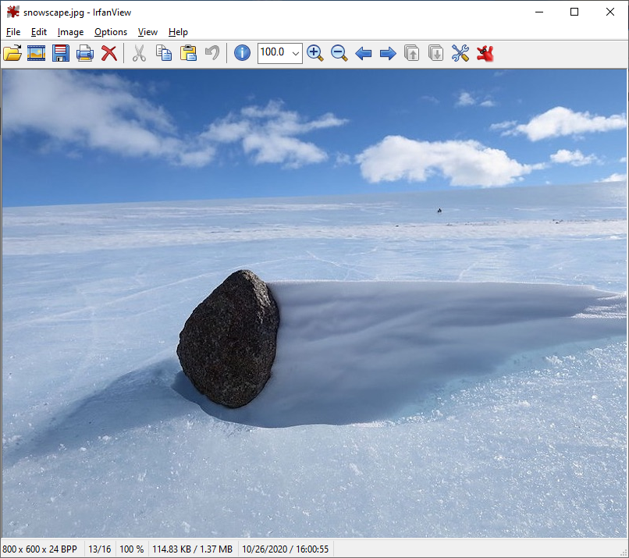
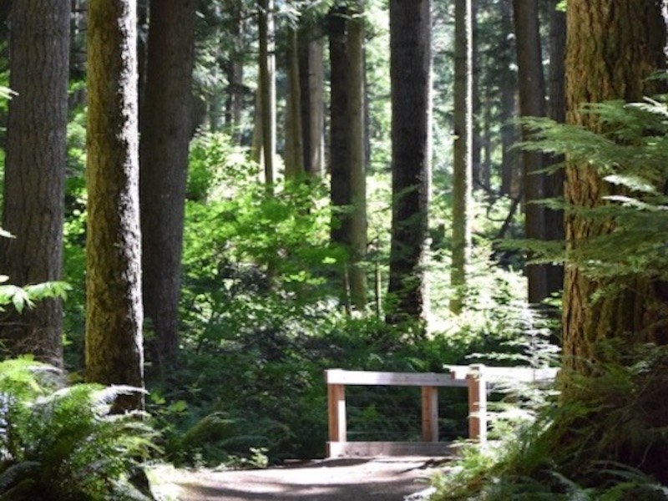
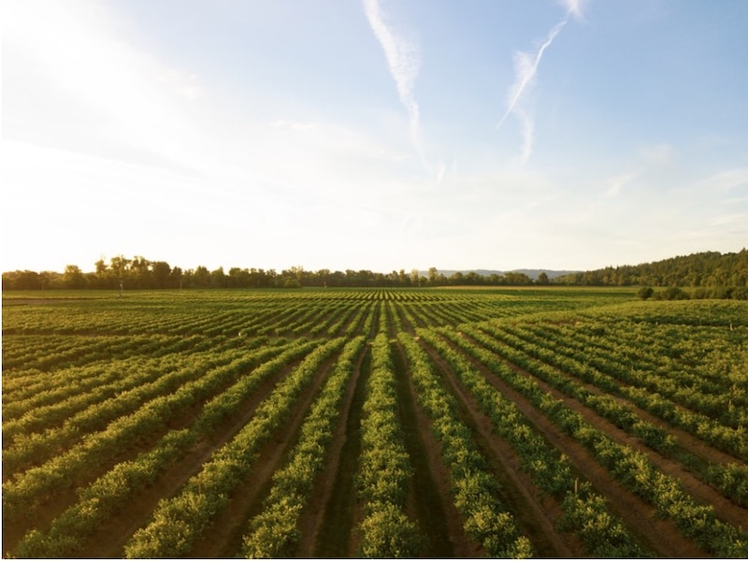
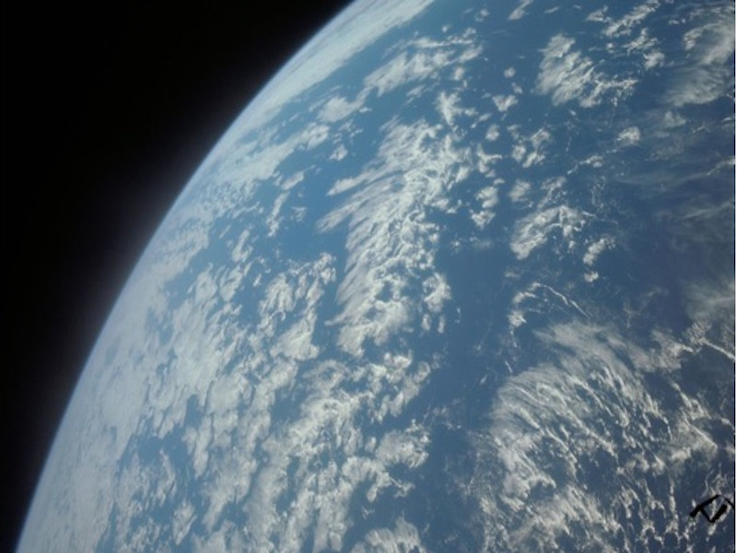
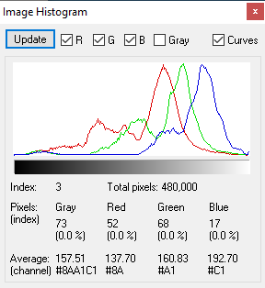
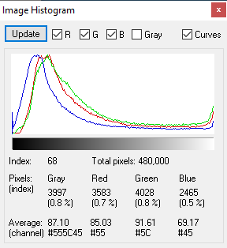
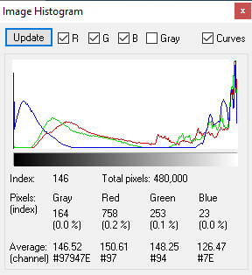
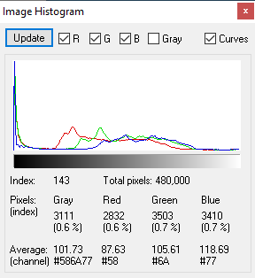
Notice that the green background shade is different, it has reds and blues in it.
Allucent
What is the lowest avg green value? G2 > value
What is the highest avg blue and red values? B2< value, R2< value

Slide 10
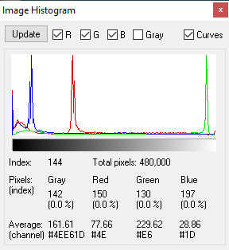
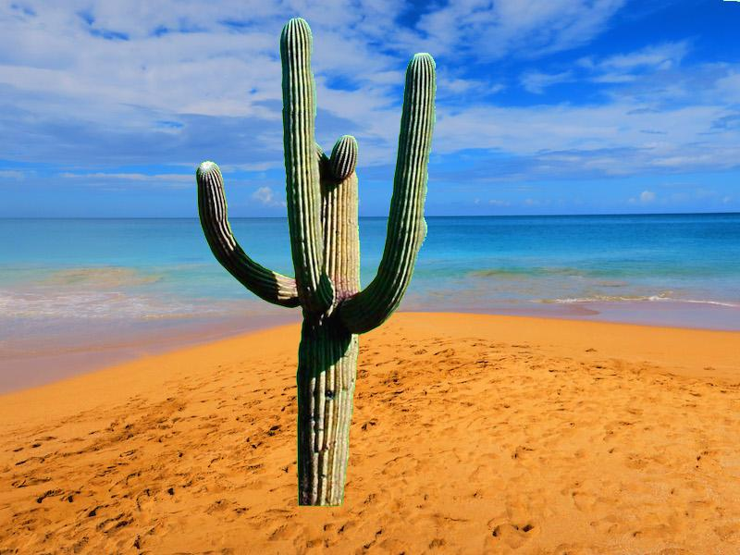
#You have two files open with pixels for each one.
image_background = Image.open("beach.jpg")
image_foreground = Image.open(“catus.jpg")
#Then you need to make a new image
image_new_image = image_new = Image.new("RGB", image_background.size)
#You need to load each image from the file into the pixal's width and height array or pixels[x,y]
pixels_background = image_background.load()
pixels_foreground = image_foreground.load()
pixels_new_image = image_new.load()
for x: ????
for y: ????
#in a nested for loop for x & y, you need to get the rgb for each pixel.
r1, g1, b1 = pixels_background [x, y]
r2, g2, b2 = pixels_foreground [x, y]
# Do some logic, using if statement checking for a specific shade of green # from the foreground, or the cactus.
# The green has to be greater than some value.
# It also has some red and blue, but a very low values.
# Hint: You will be using 'and' operator as part of the logic in
# the if statement checking for green, red and blue
#The best way to do this is to randomly print out the rgb values of the foreground, i.e. the cactus,
# to see what are the foreground image's green background values or look at the histogram.
if ????:
# To update the new image, you will use either one of these.
#The logic (if statement) depend on what you discover from the green, red and blue values. pixels_new_image[x, y] = (r1, g1, b1)
# or /else
pixels_new_image[x, y] = (r2, g2, b2)
Make sure you save the new image image_new_image.save("the_file_goes_here.jpg")
We are checking the green screen pic, or the foreground, or in this example the cactus
If g2>? and r2<? and b2<?
True
False

Slide 11
